Slide 1
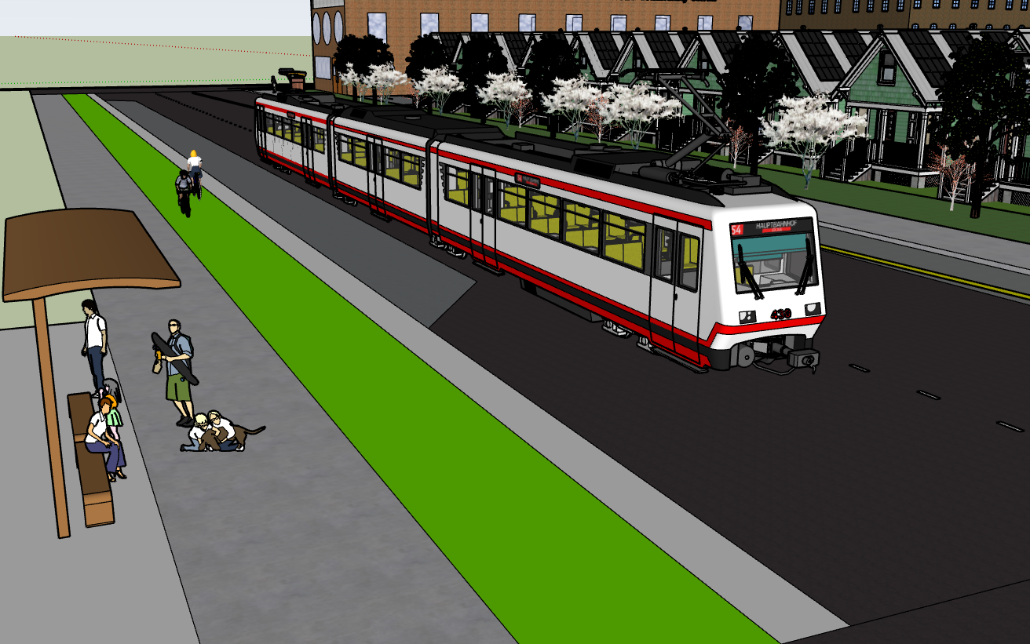

Woodland Park Complex
A modern mixed use development in the heart of the city that aims to provide space for all
Mira Sullivan

Slide 2
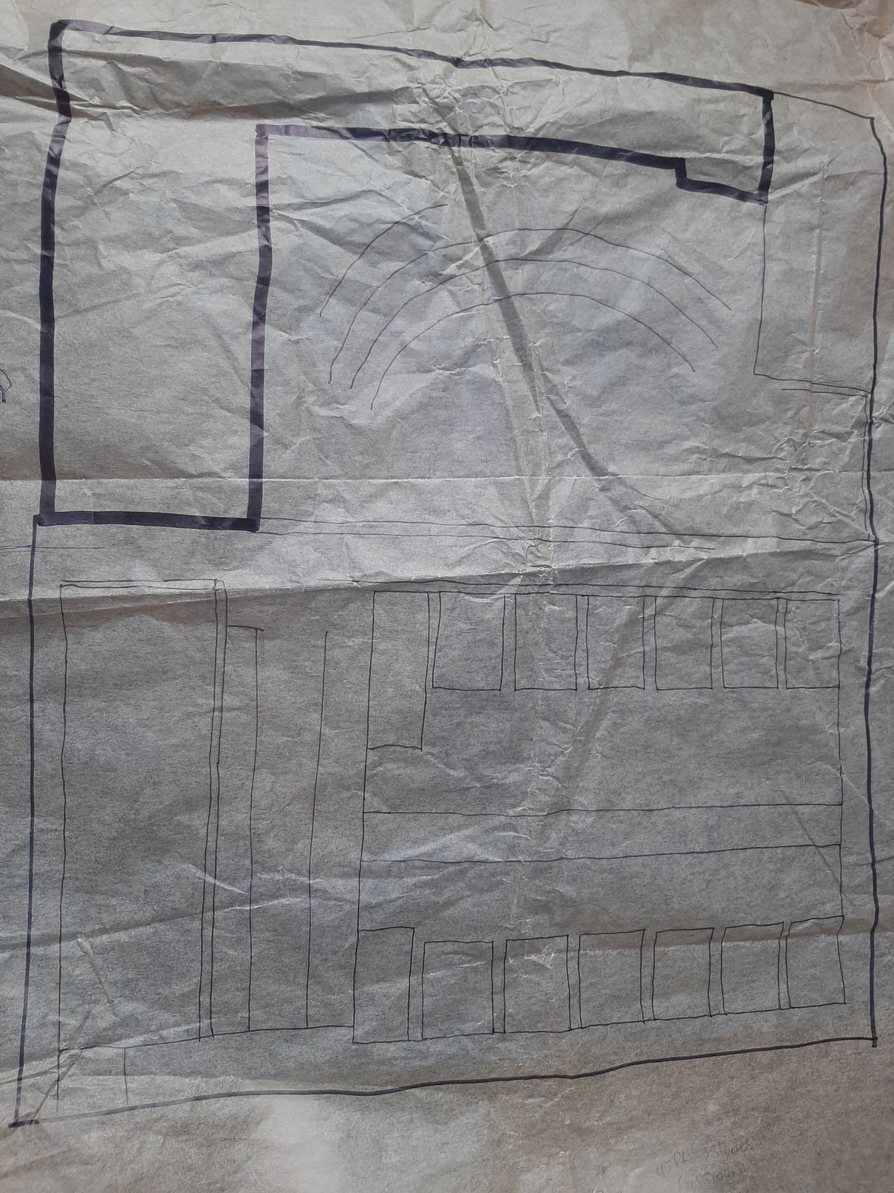
Concept Plan
Zoning C-R

Slide 3
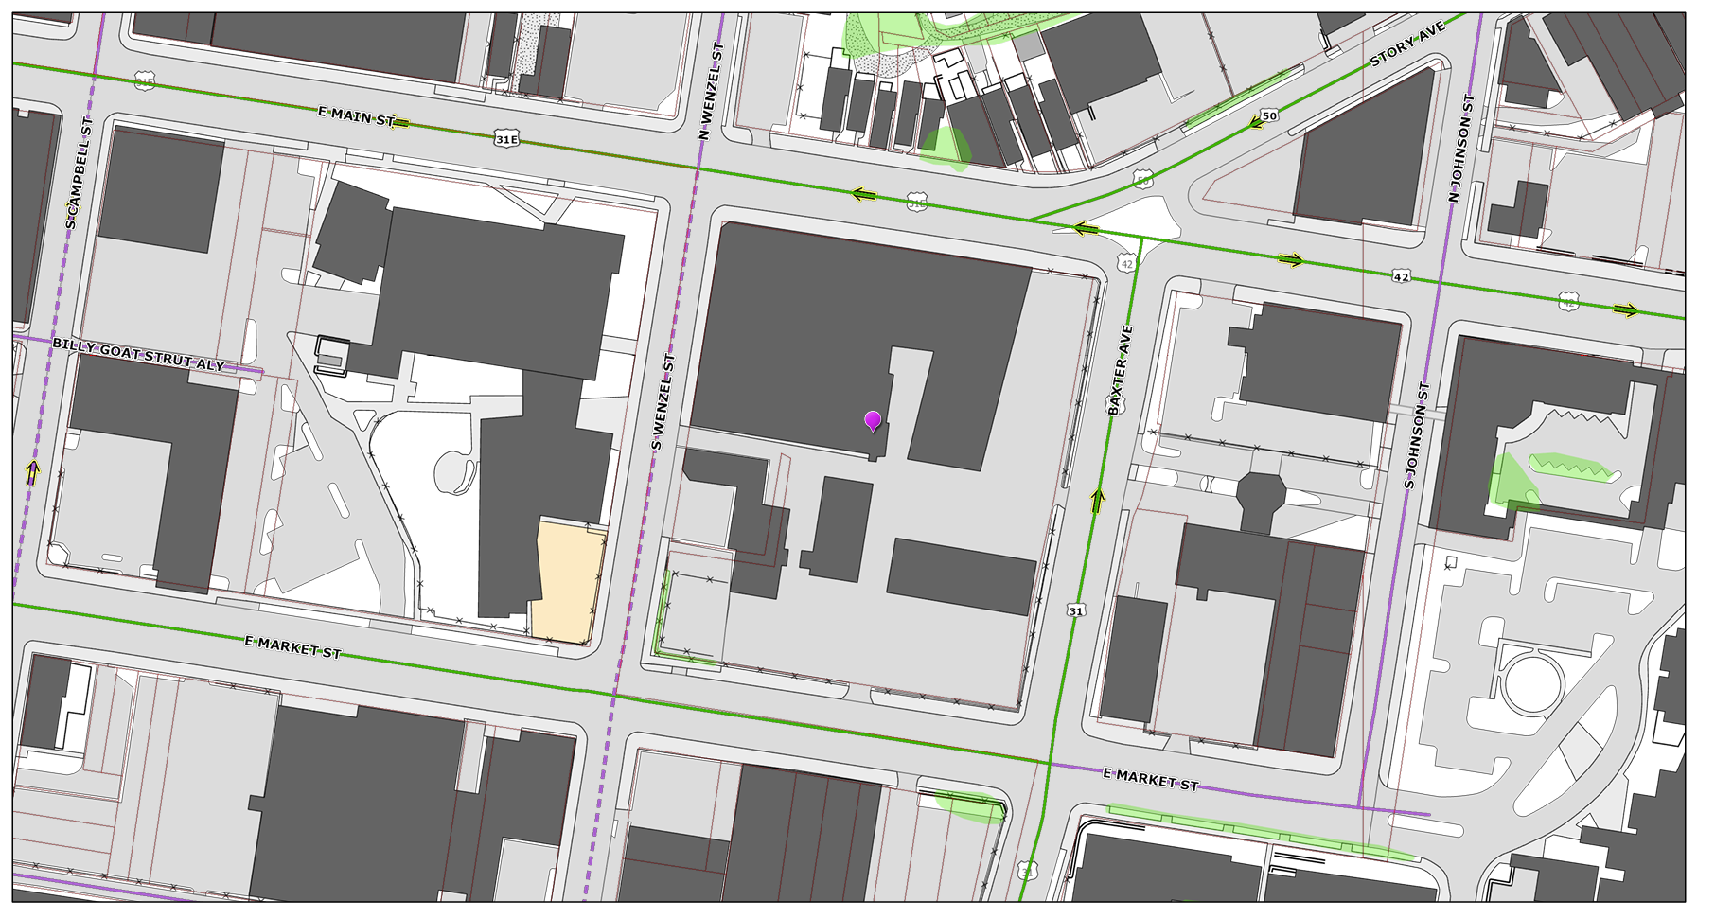
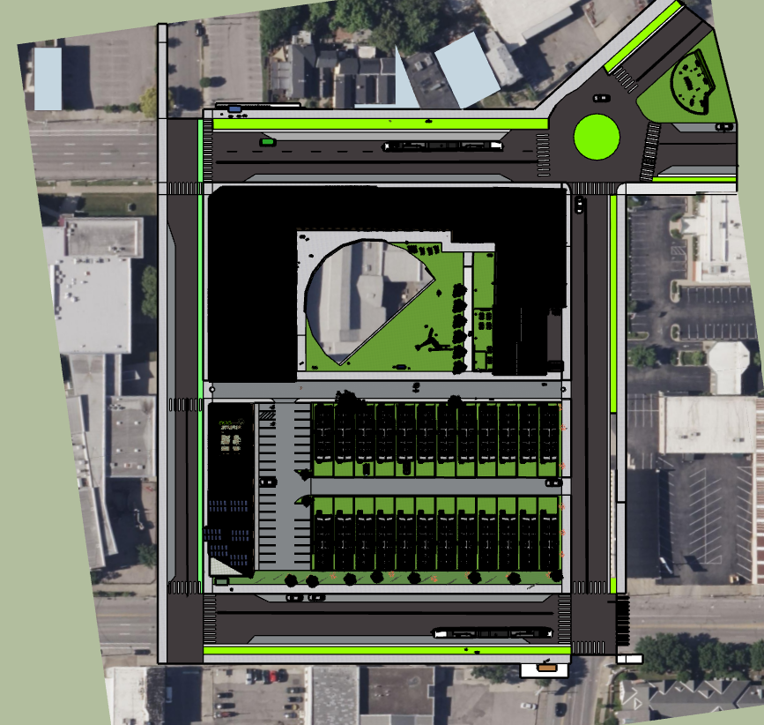
Before and After

Slide 4
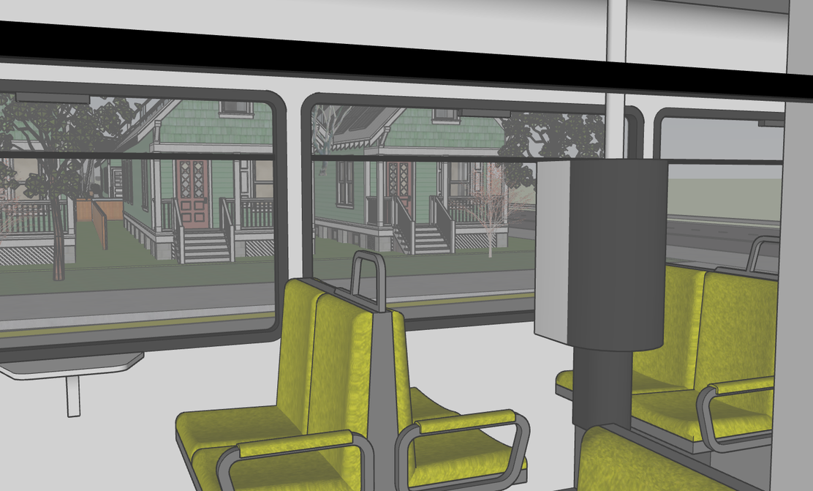
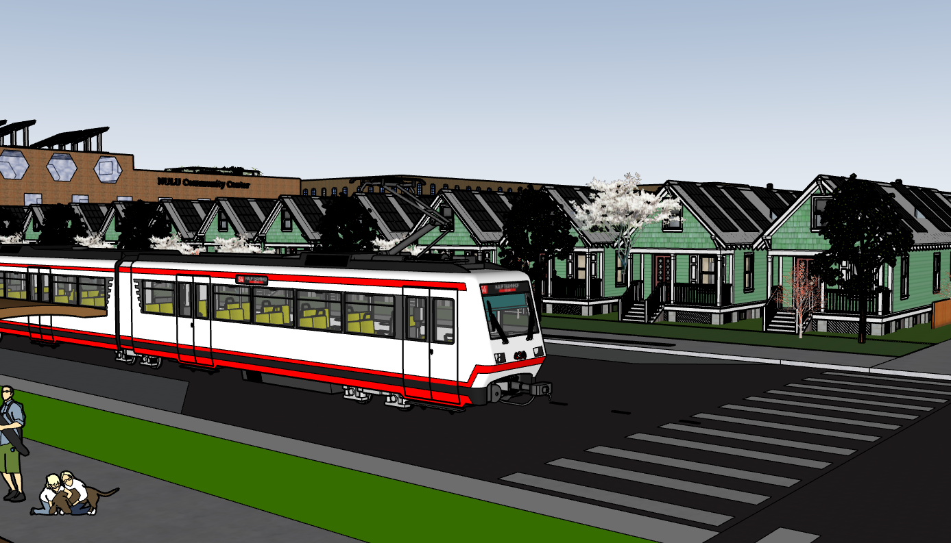
The Jounrey Begins
Get off the light rail at the corner of Market and Baxter

Slide 5
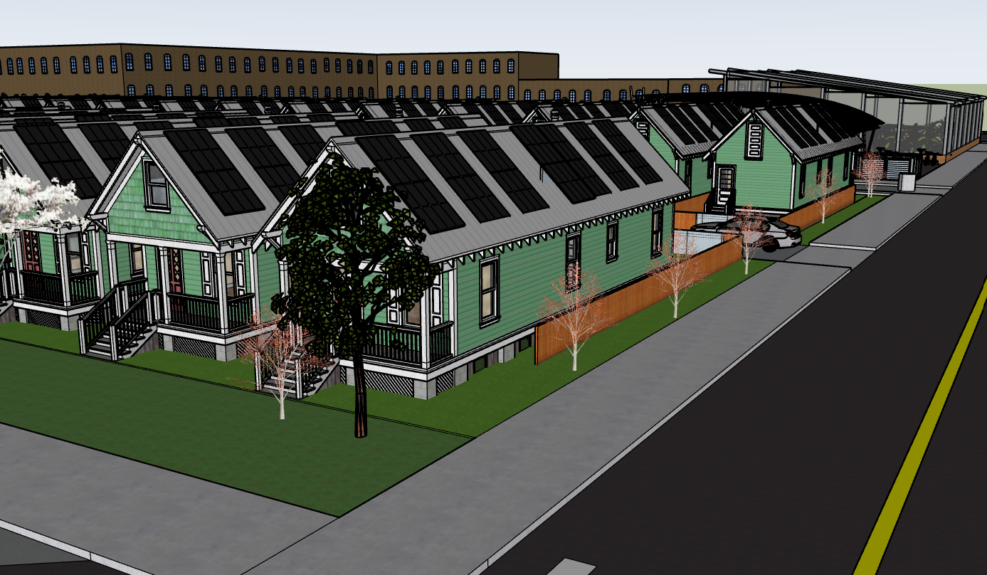
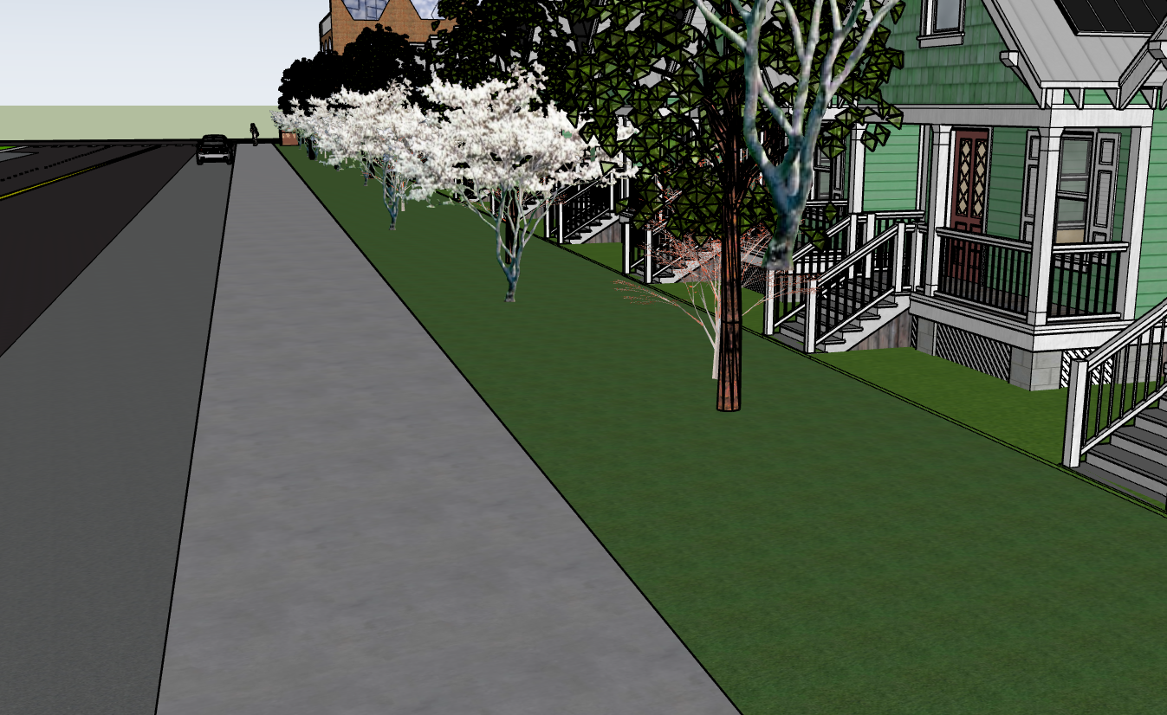
Cross the street and and turn left down market towards Wenzel

Slide 6
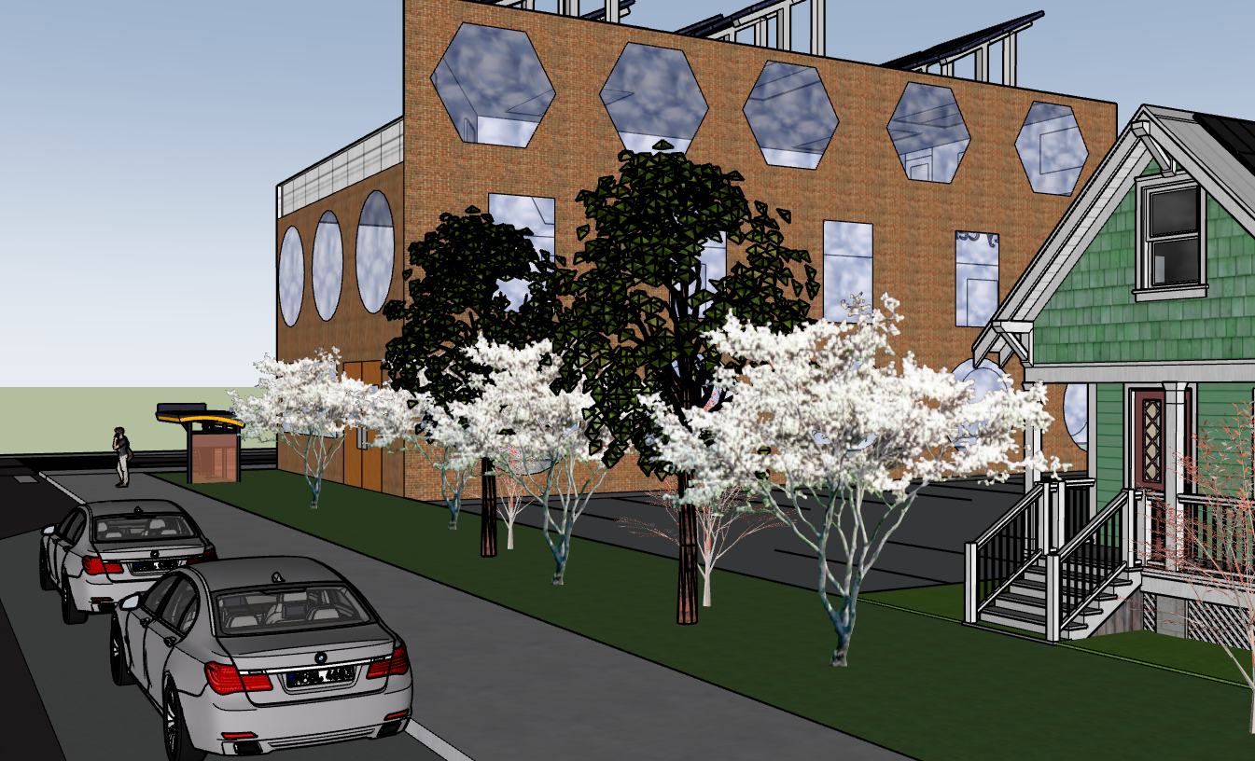







Kitchen
Hair Dryer
Coffee Maker
Washer
Wifi
Iron
Parking
Cable TV

Slide 7
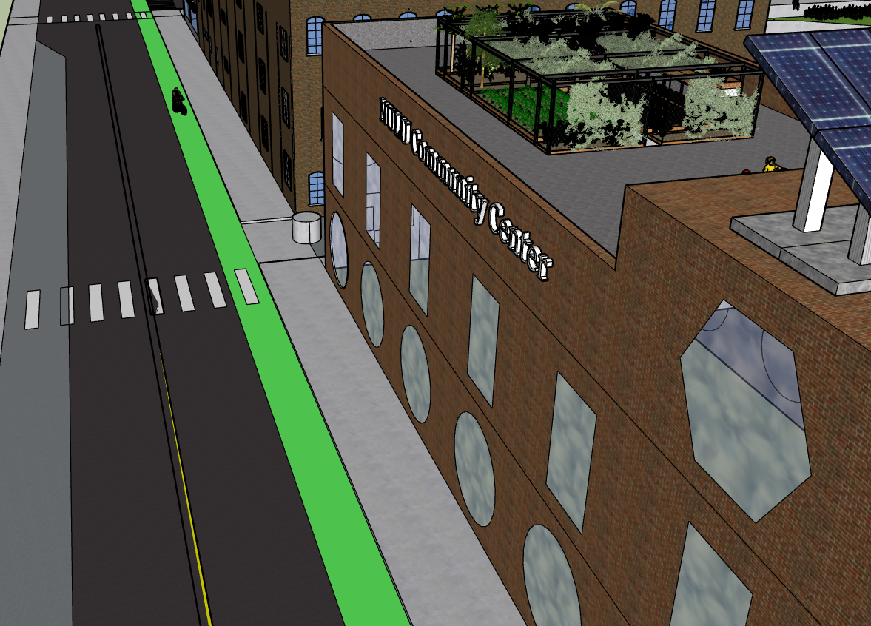
The NULU Community Center
Corner of Wenzel and Market

Slide 8
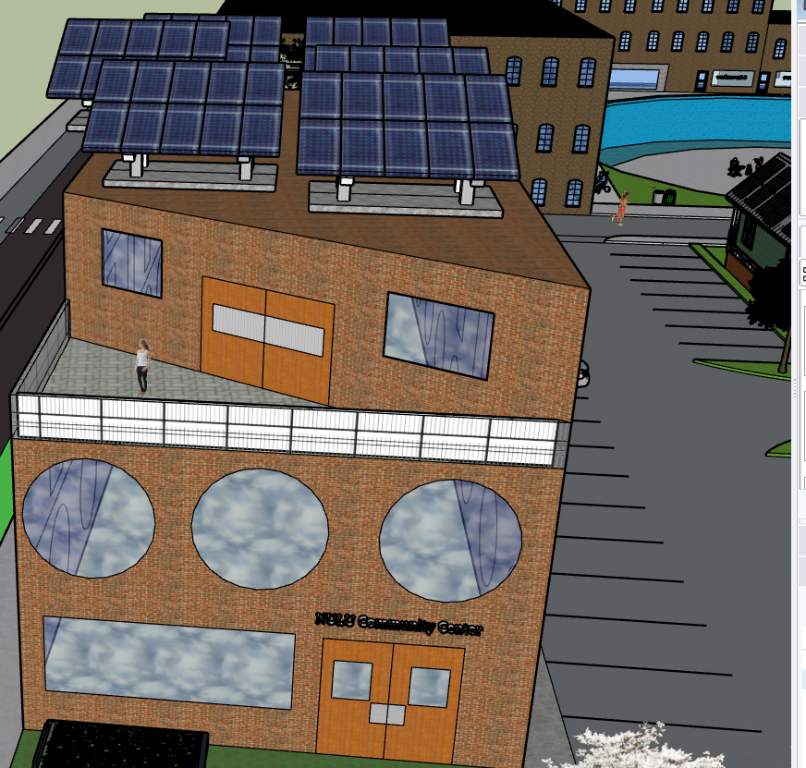
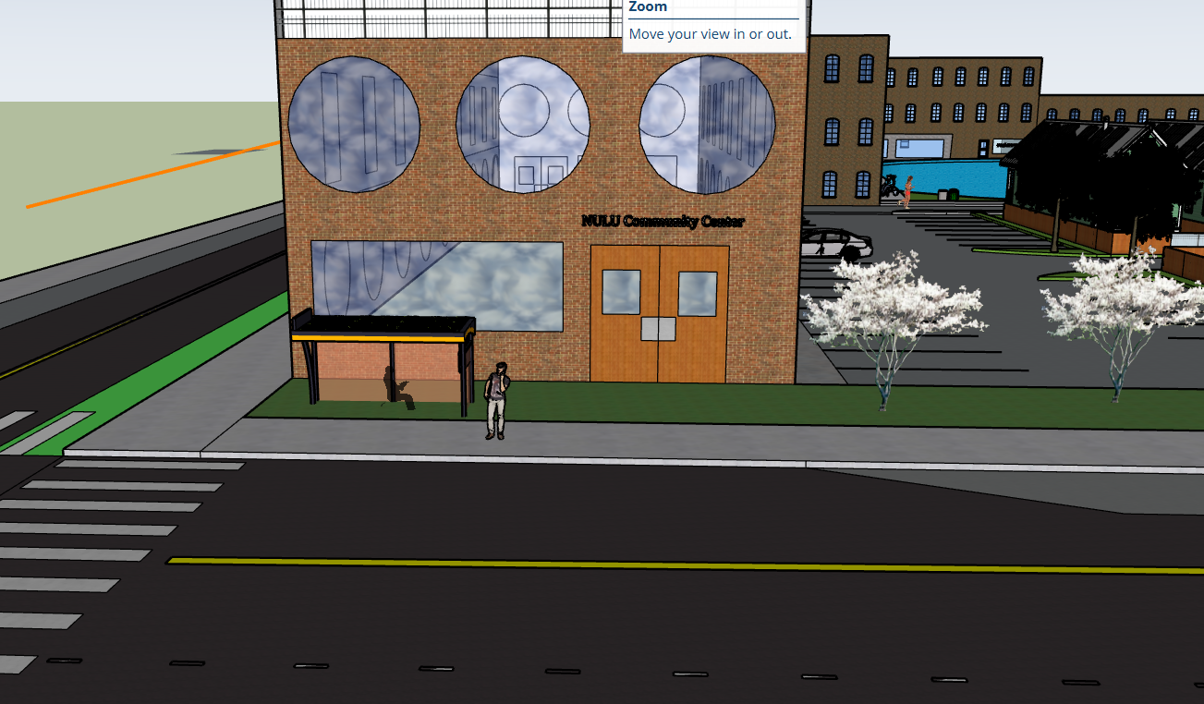
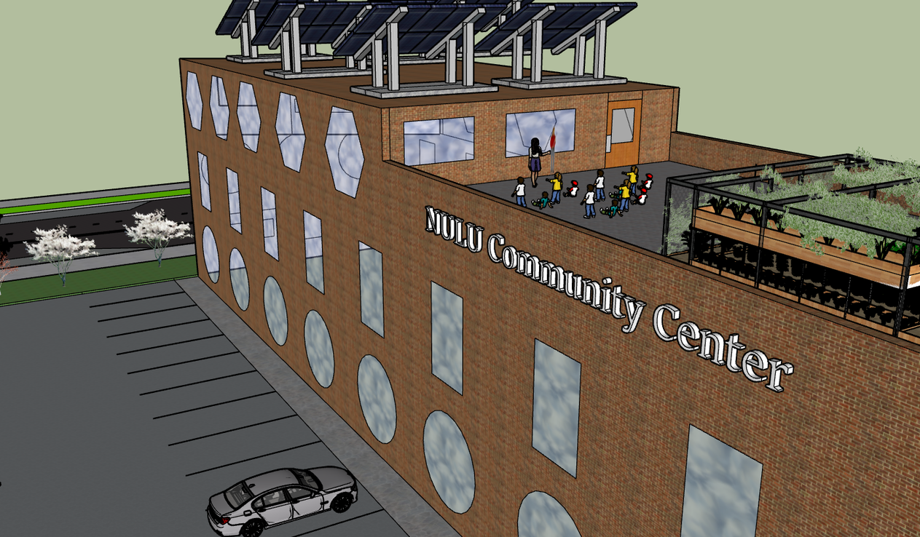

Slide 9
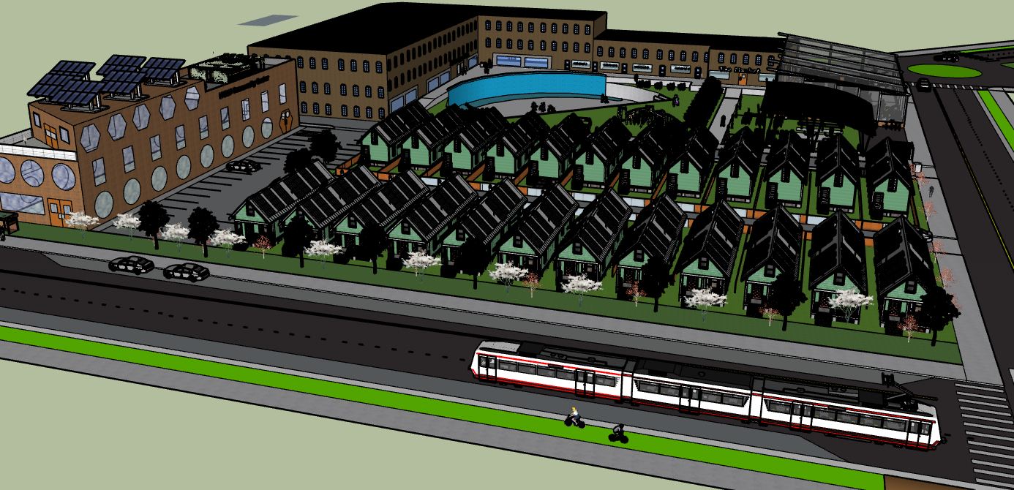
Amenities off Market

Slide 10
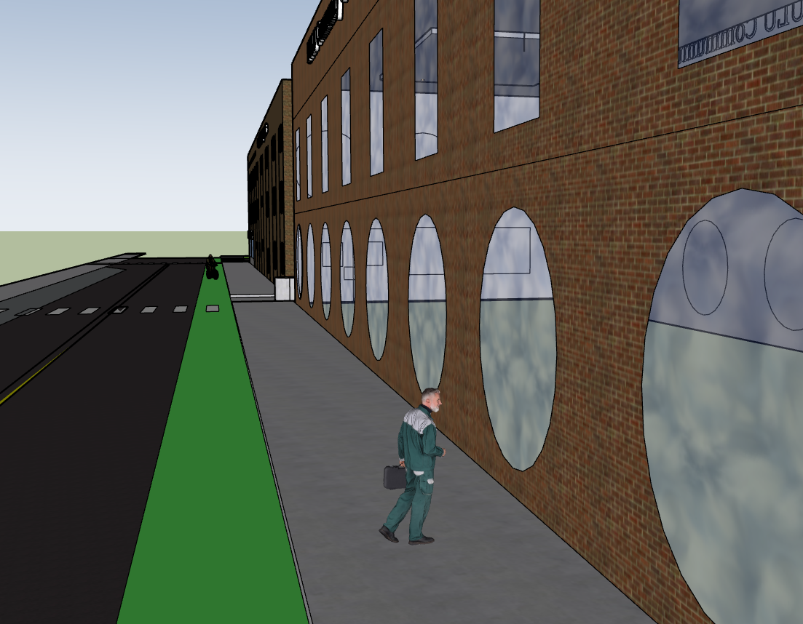
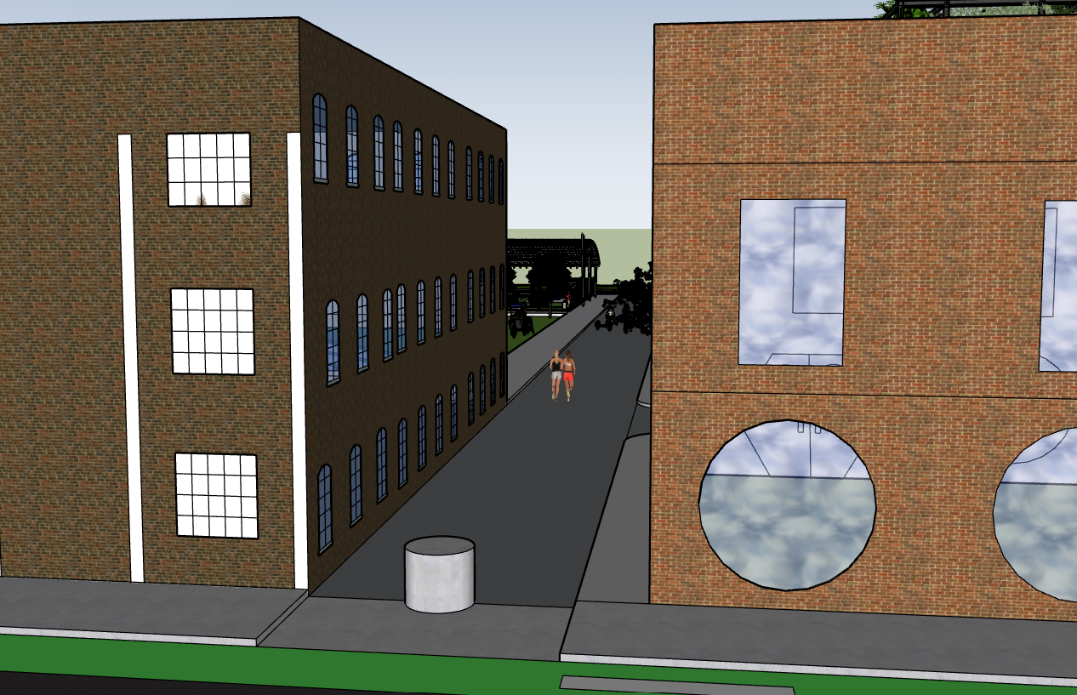
Walk down Wenzel towards Main

Slide 11
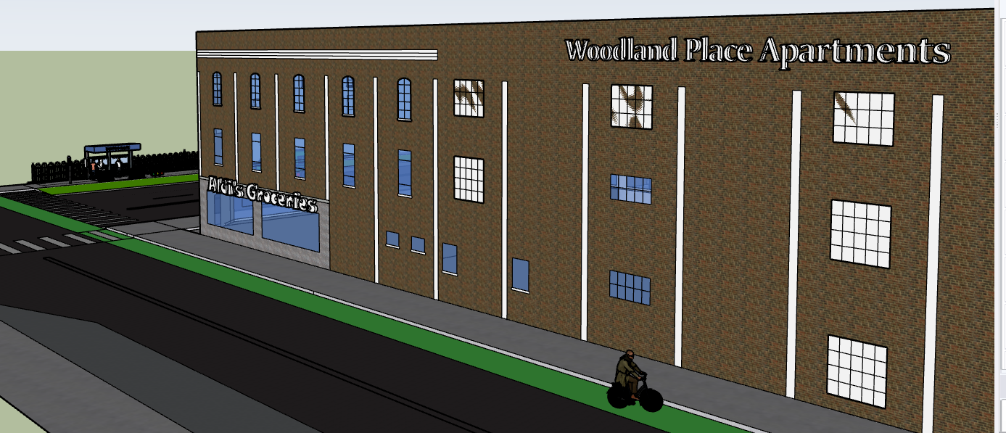
Woodland Apartments and Aldi’s Groceries

Slide 12
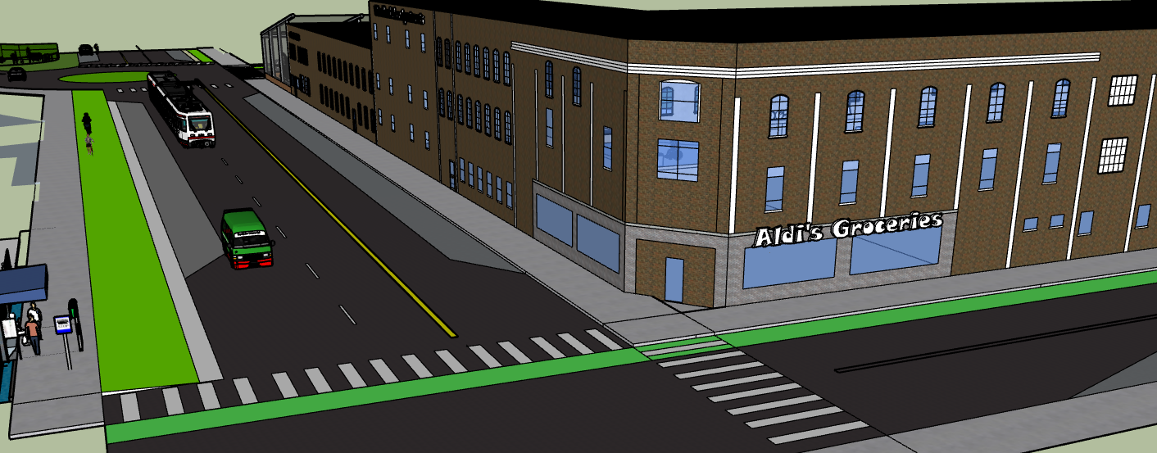
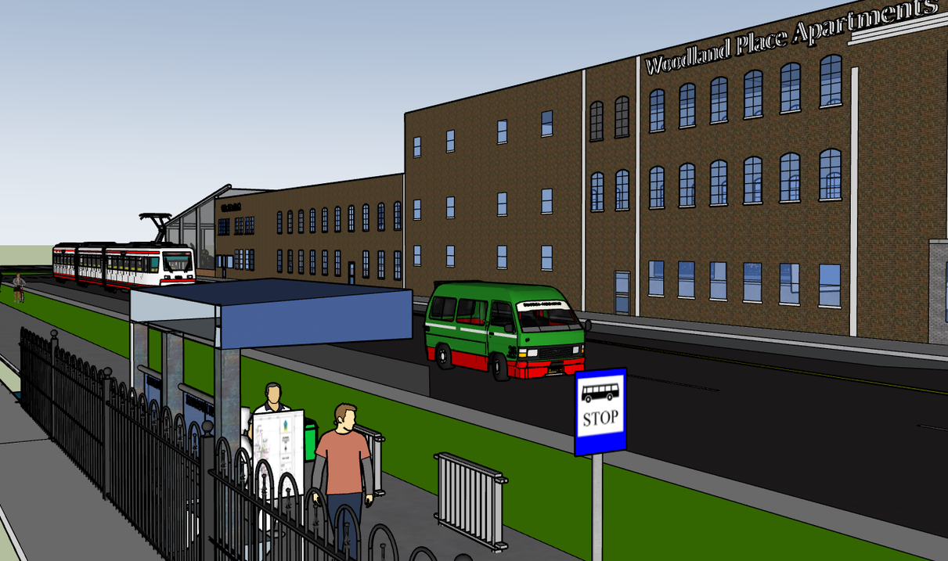
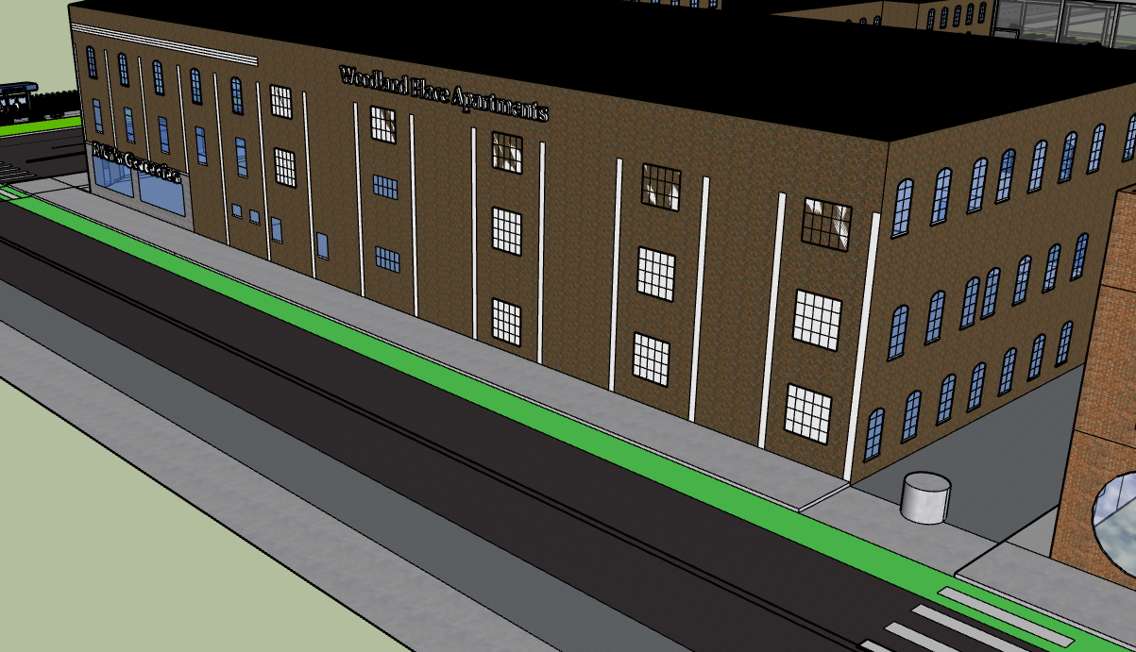

Slide 13
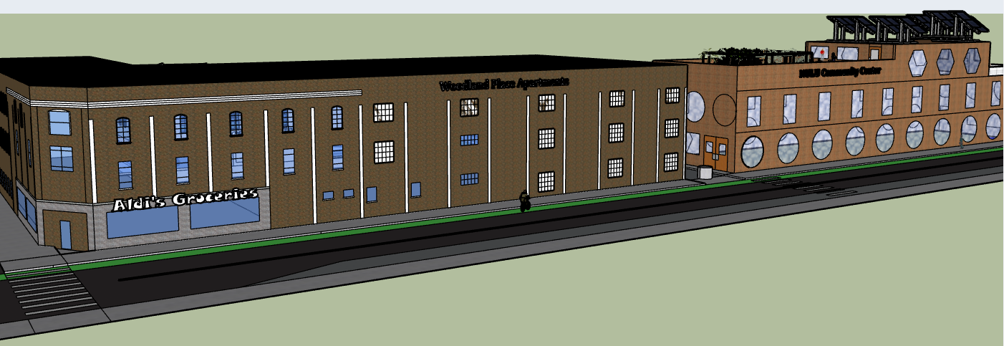
Amenities off Wenzel

Slide 14
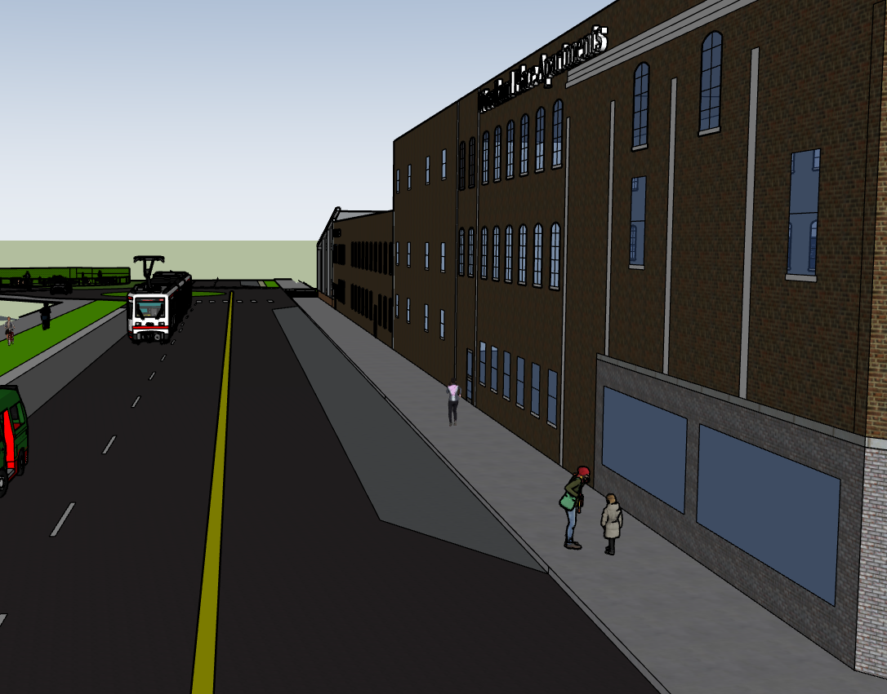
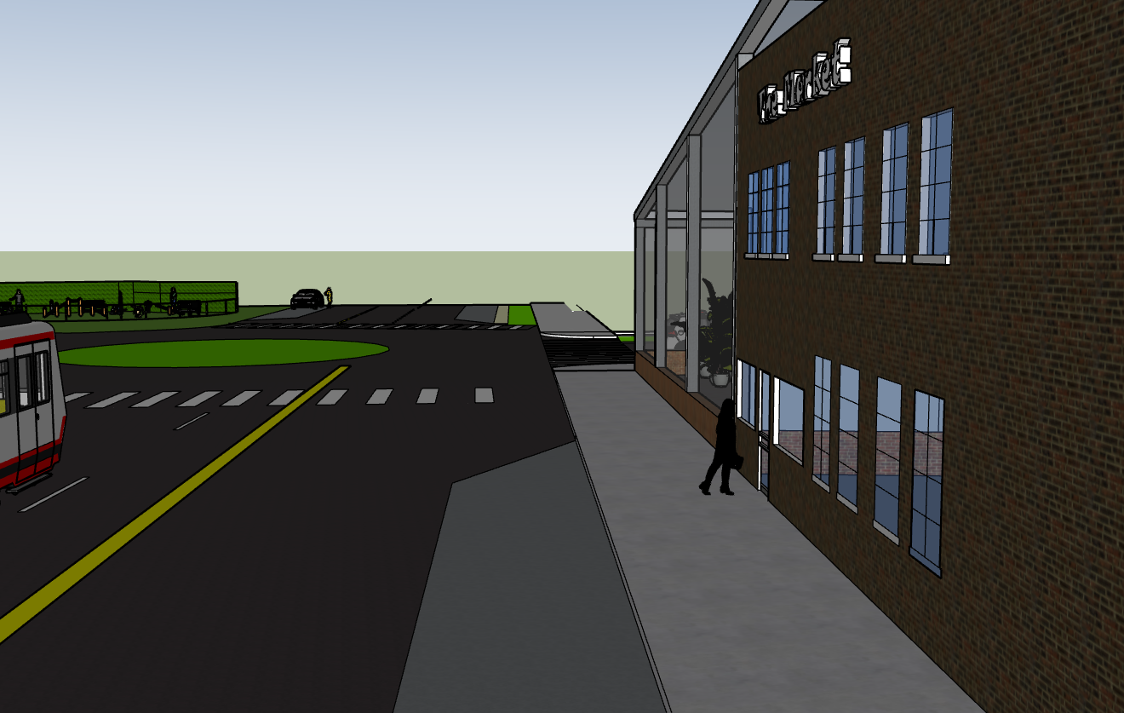
Walk Down Main street towards Baxter Ave

Slide 15
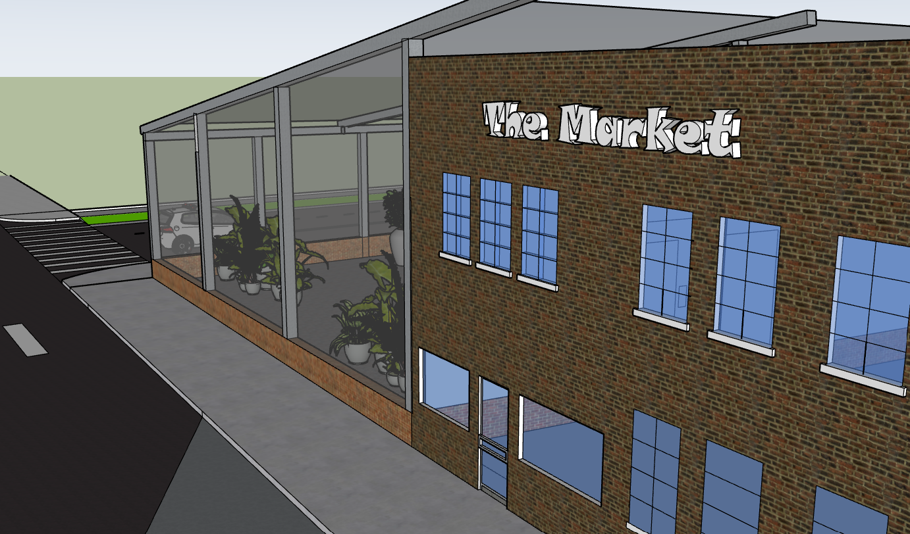
The Market
On the corner of Baxter and Main sits a food stall and marketplace with attached greenhouse for sitting

Slide 16
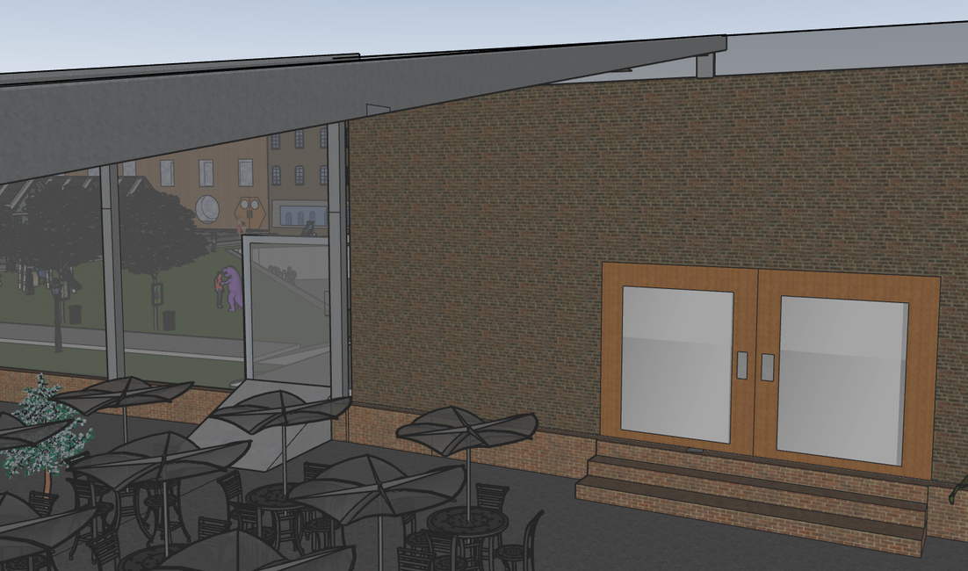
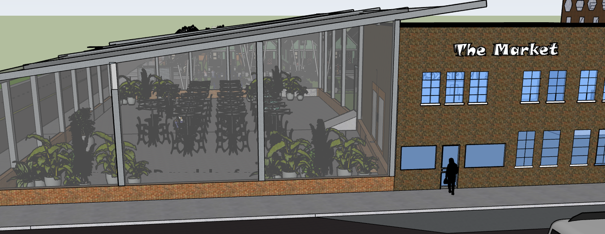
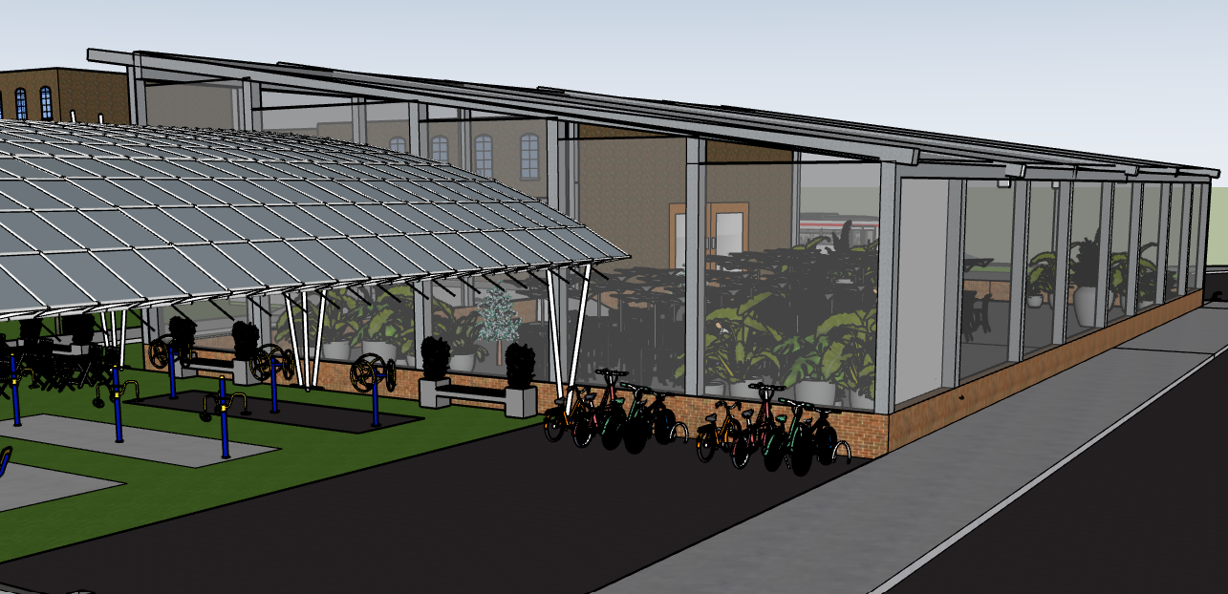
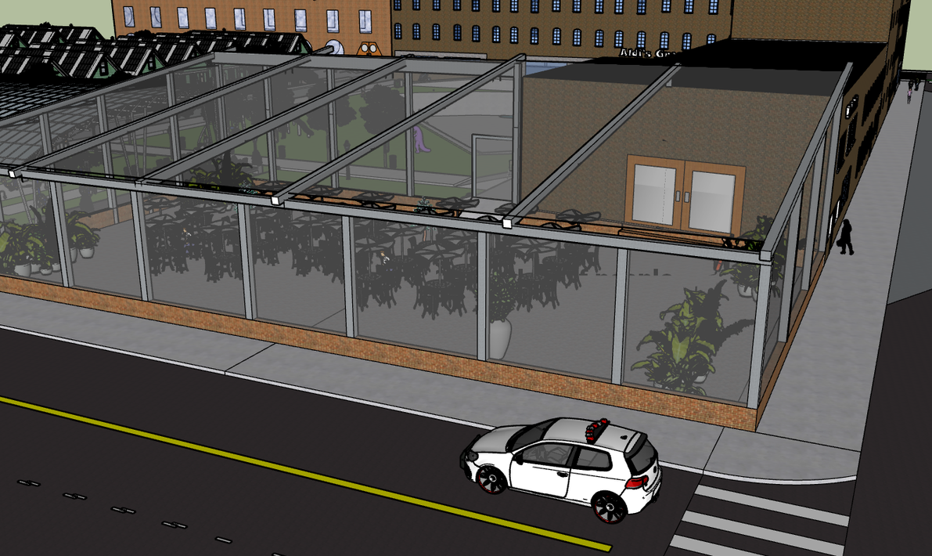

Slide 17
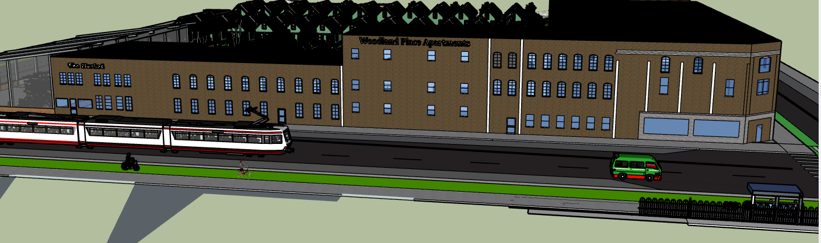
Amenities off Main

Slide 18
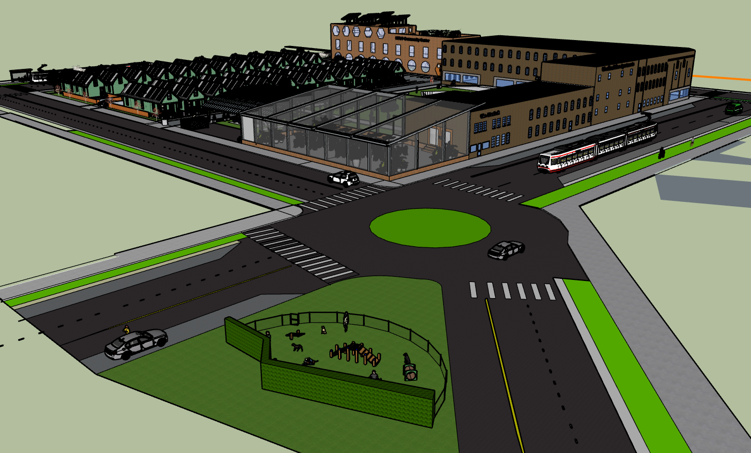
Kitchen
Hair Dryer
Coffee Maker
Washer
Wifi
Iron
Parking
Cable TV

Slide 19
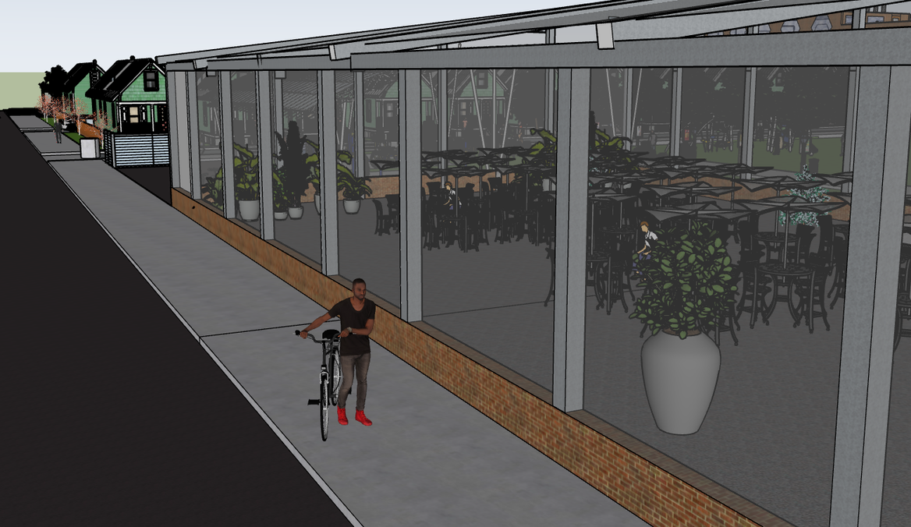
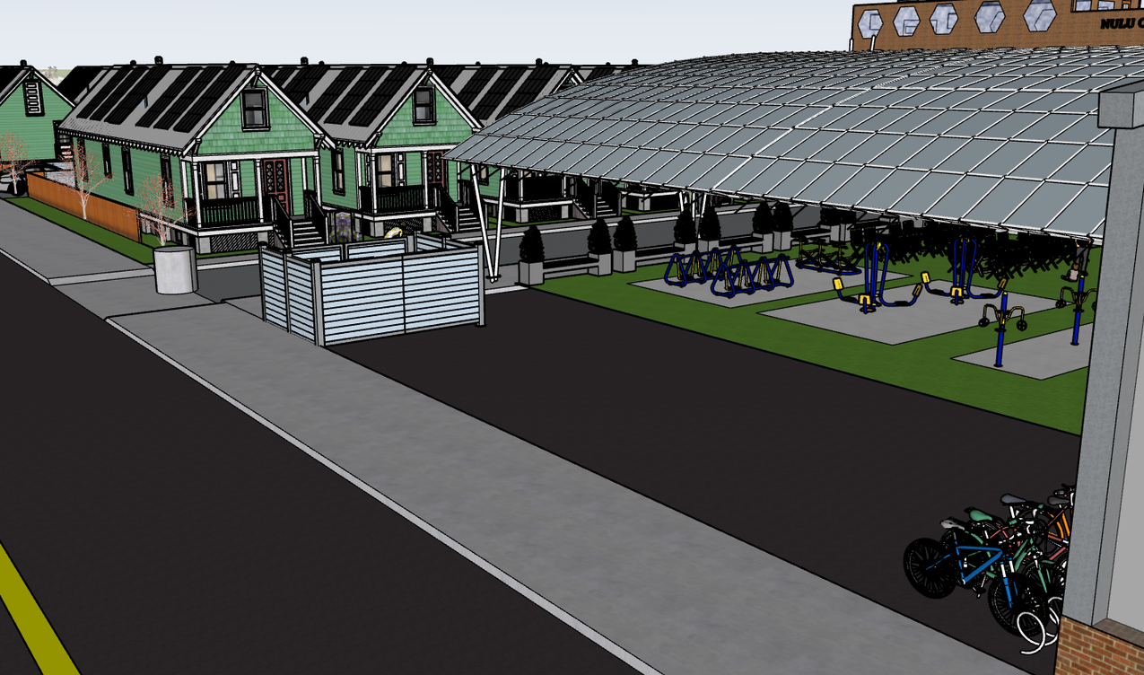
Walk down Baxter towards Market

Slide 20
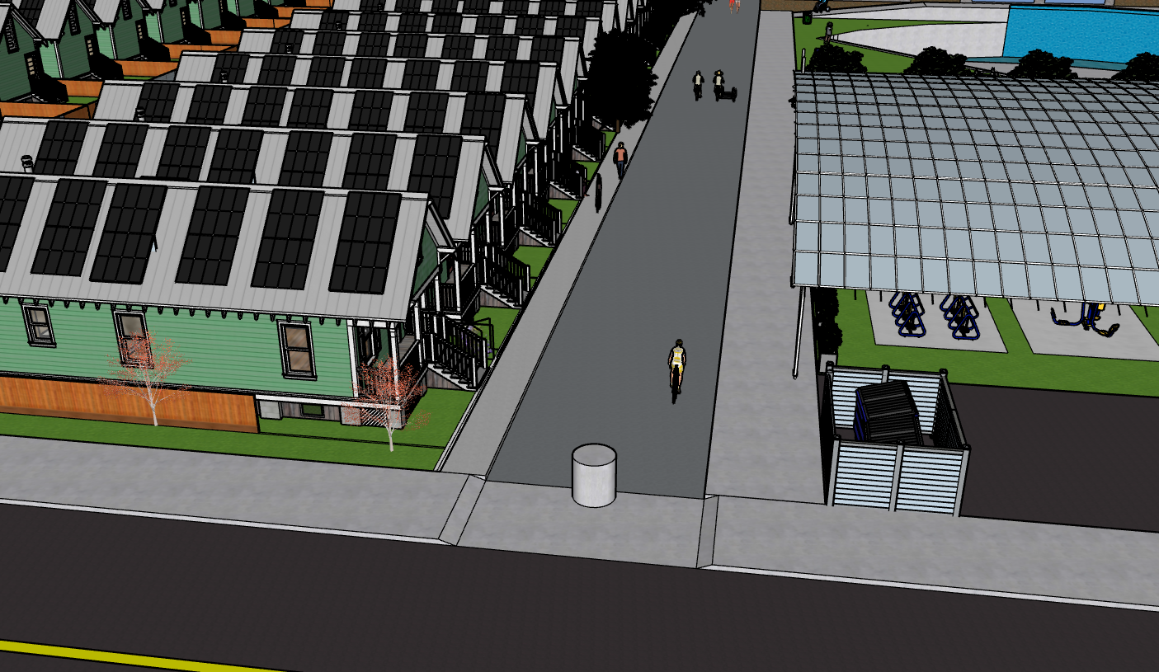
Woodland Place Court
Street that runs through center of complex between Wenzel and Baxter

Slide 21
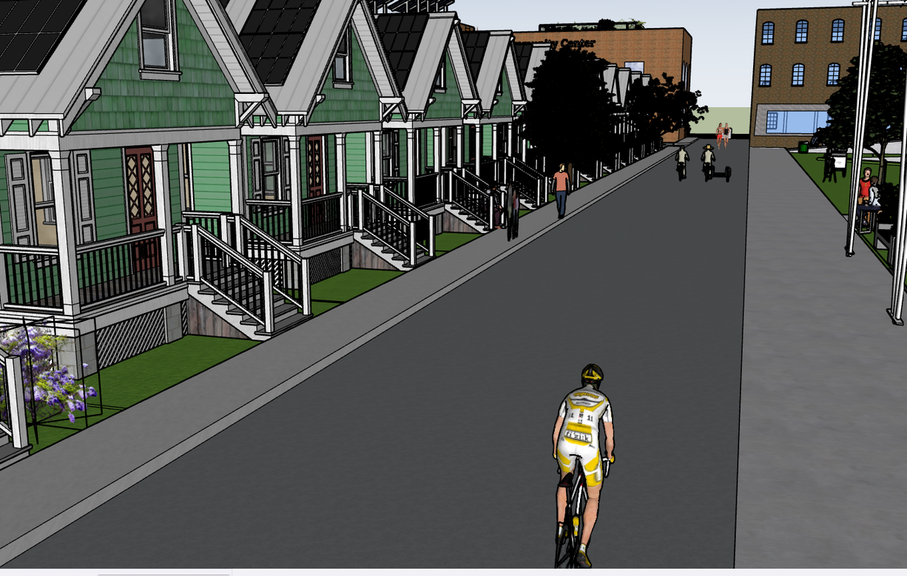
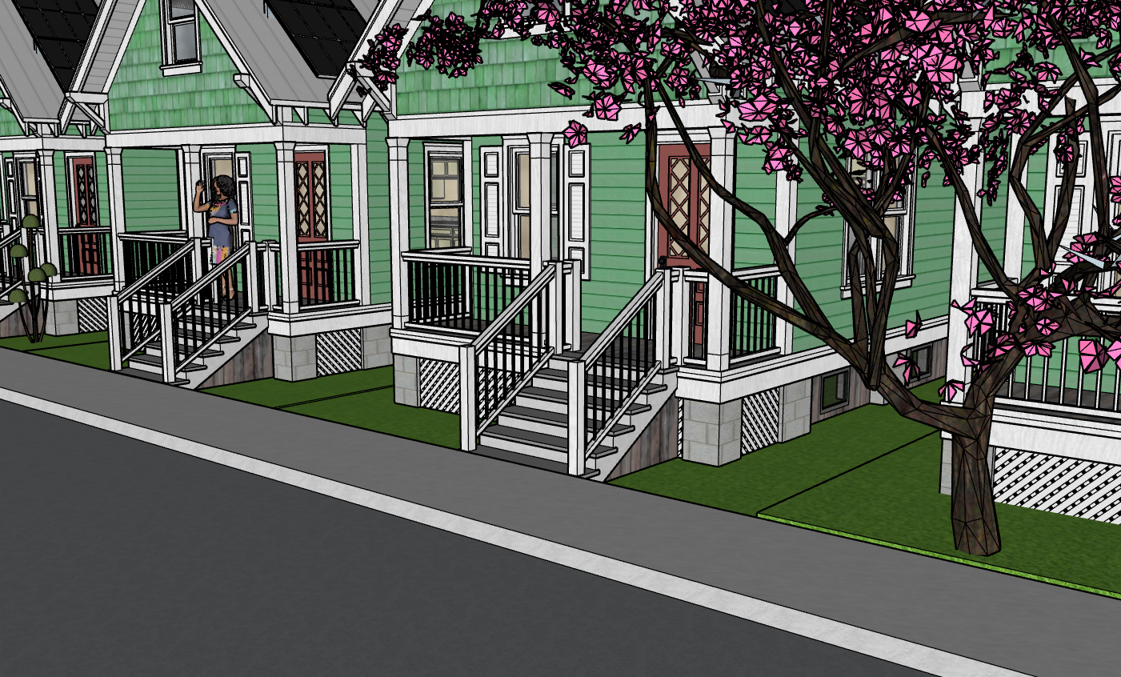
In the Court
Single family Housing
Bike and Walk Friendly Paths

Slide 22
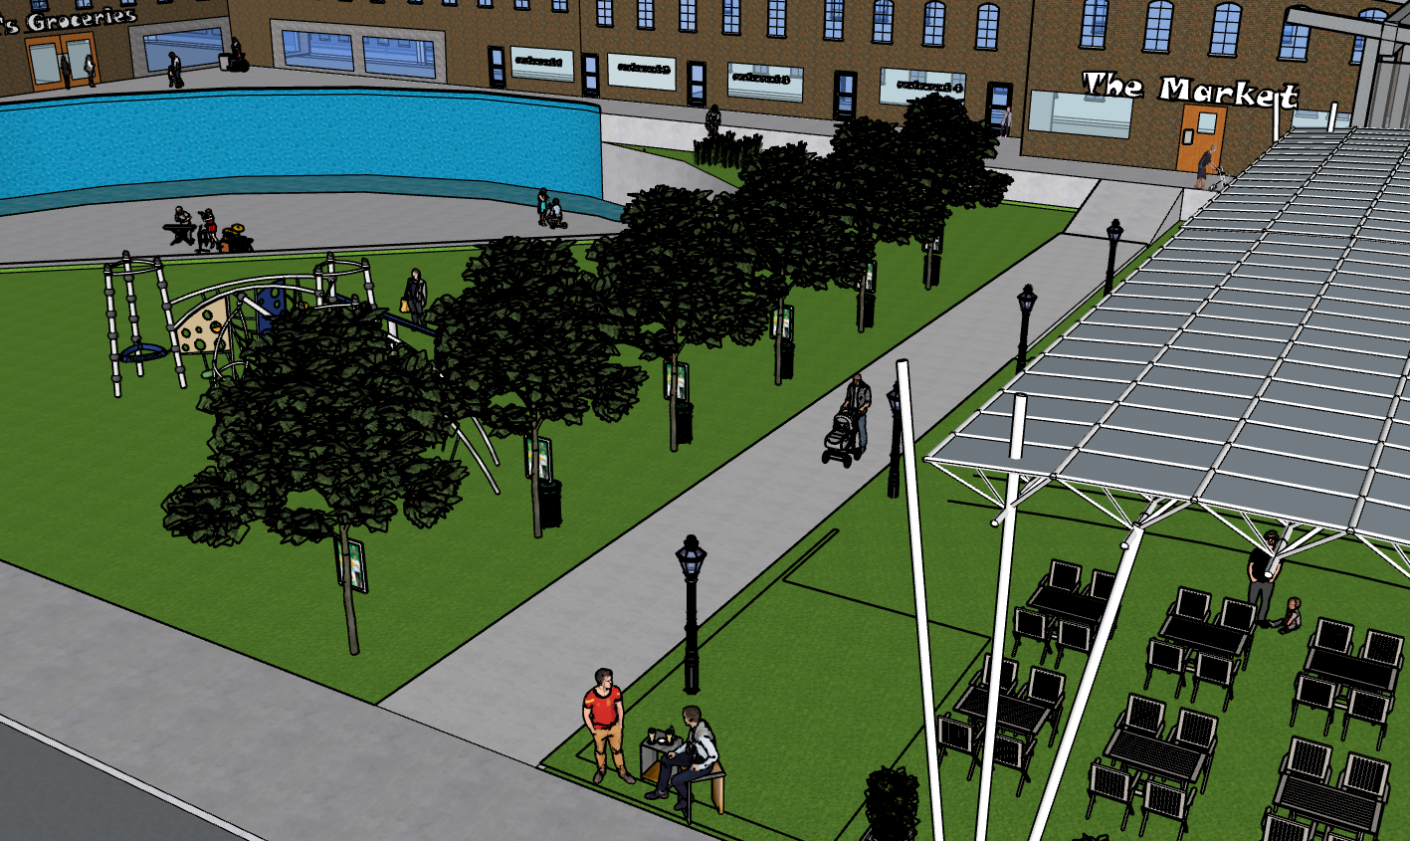
Kitchen
Hair Dryer
Coffee Maker
Washer
Wifi
Iron
Parking
Cable TV

Slide 23
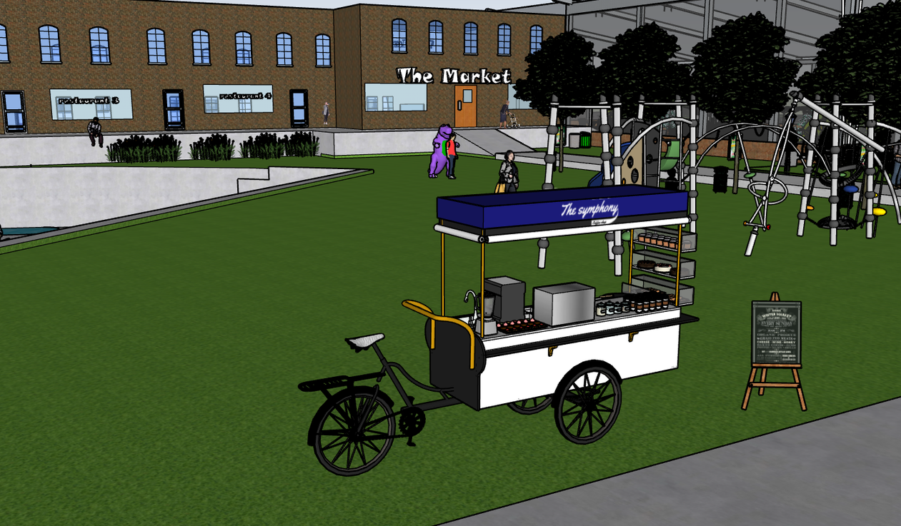
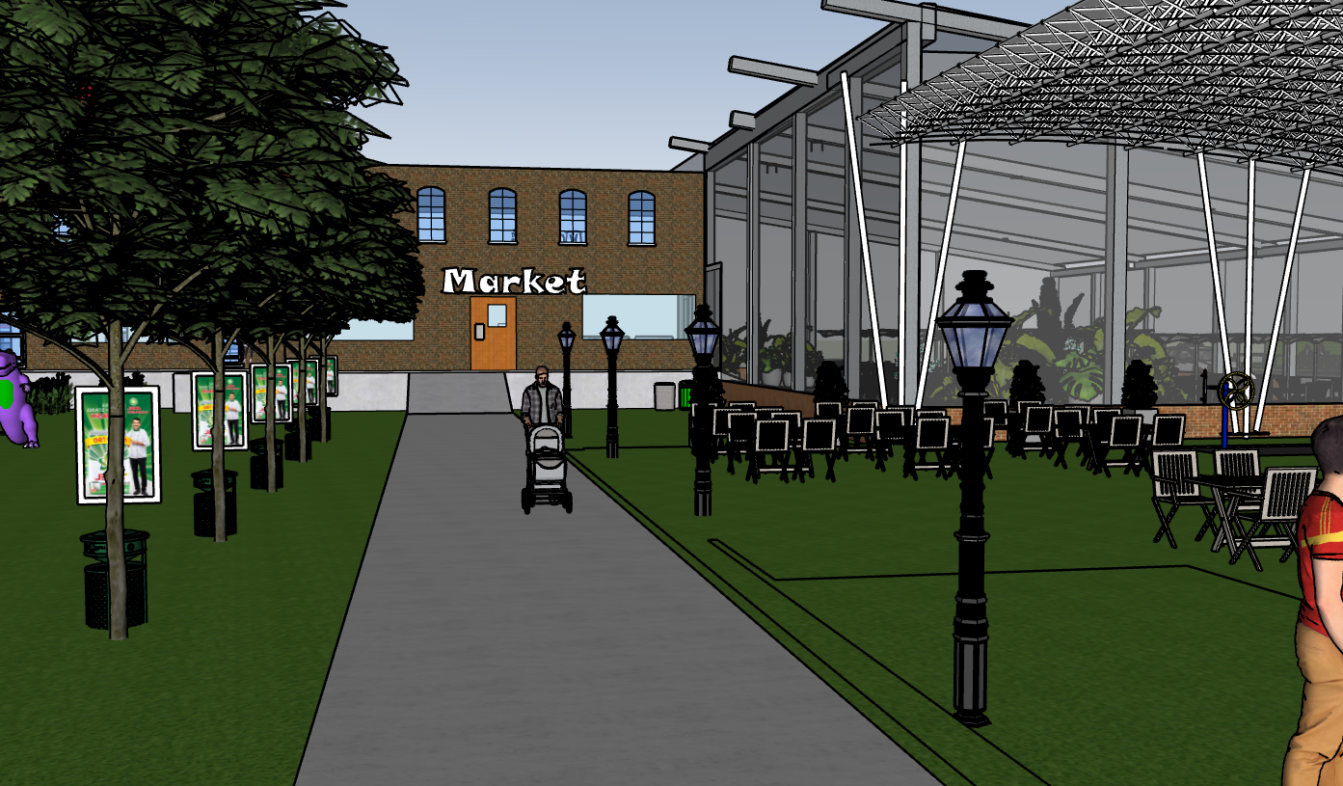
In the Court

Slide 24
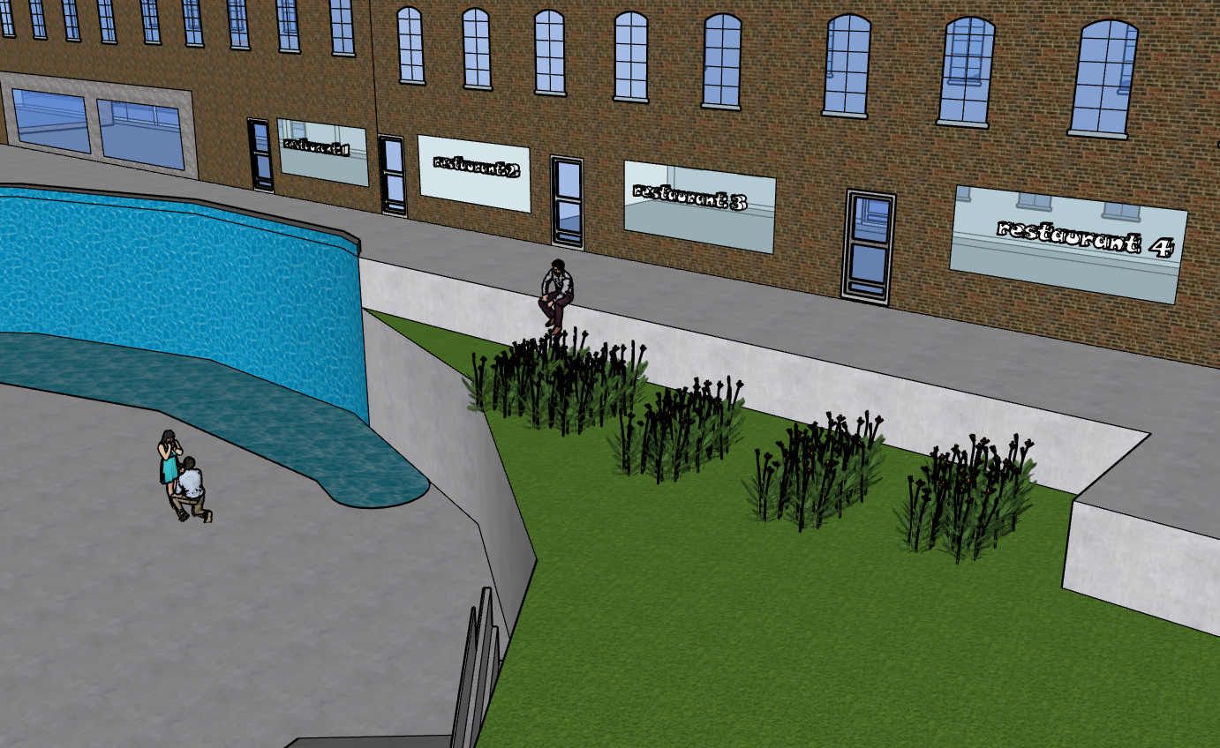

Slide 25
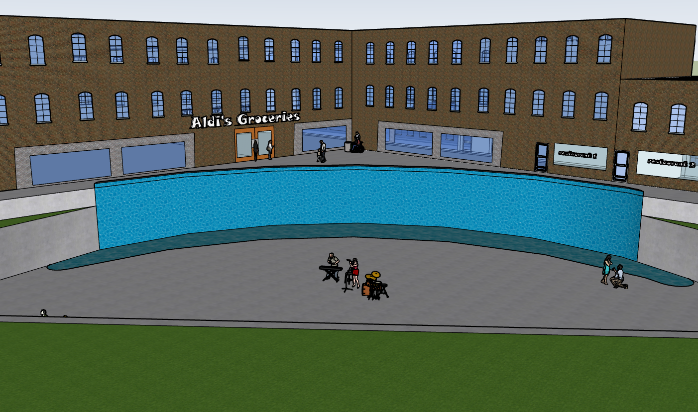
Woodland Apartments and Aldi’s Groceries (2nd Access Point)

Slide 26
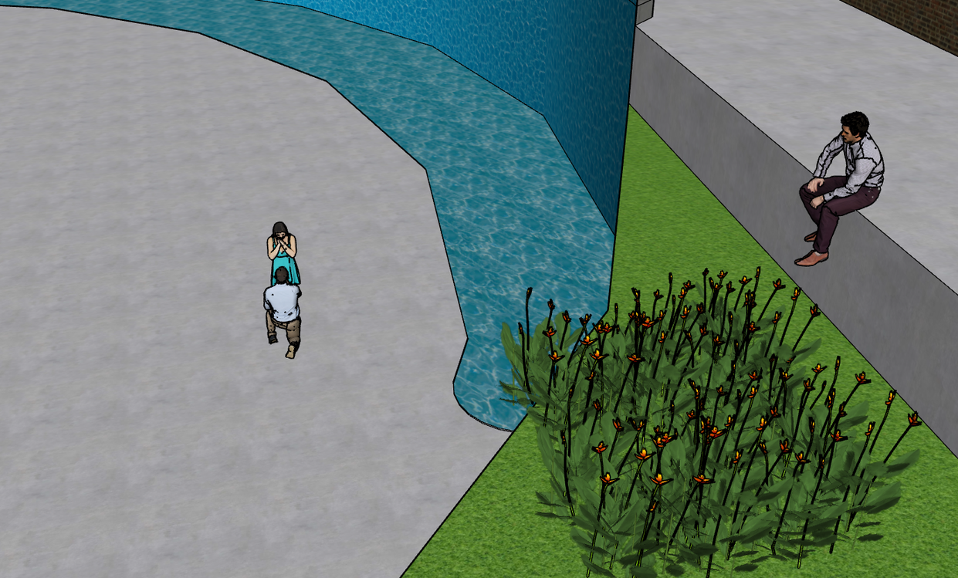
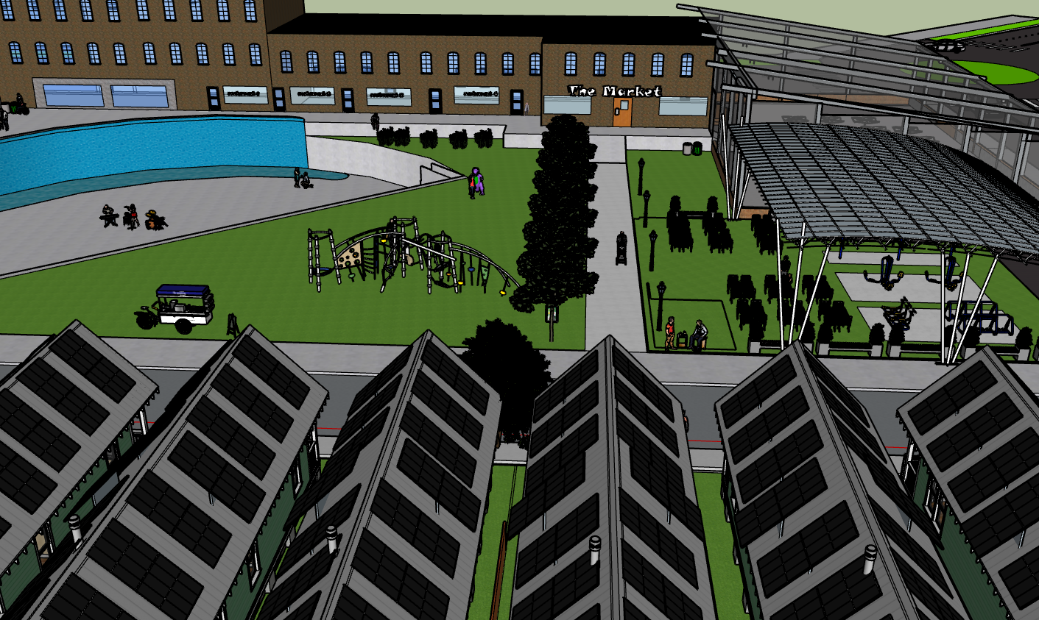
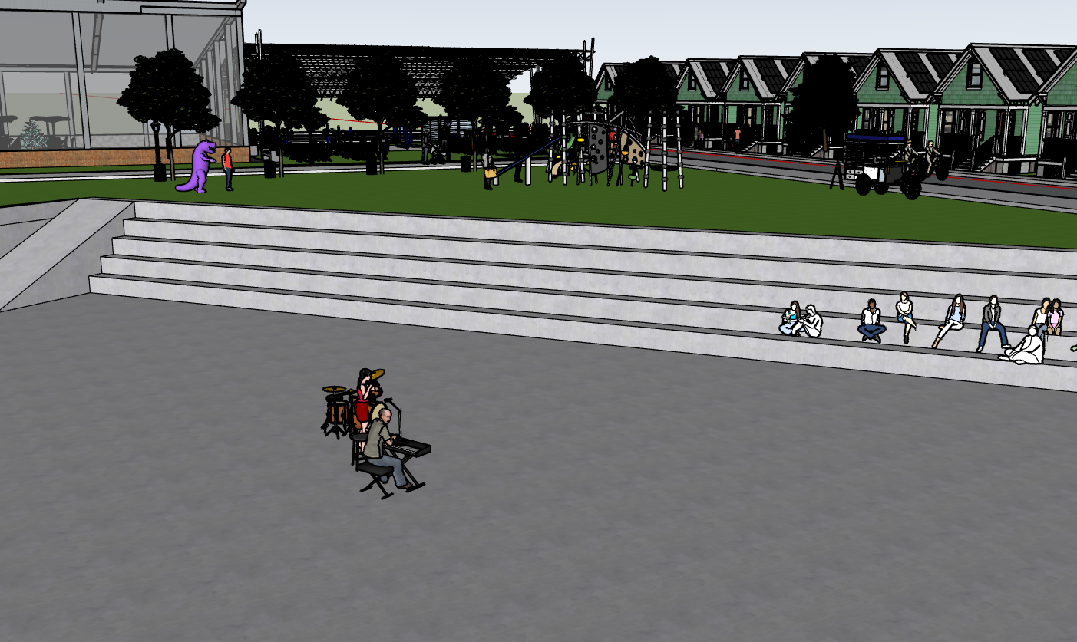
A Water Feature
In the Court

Slide 27
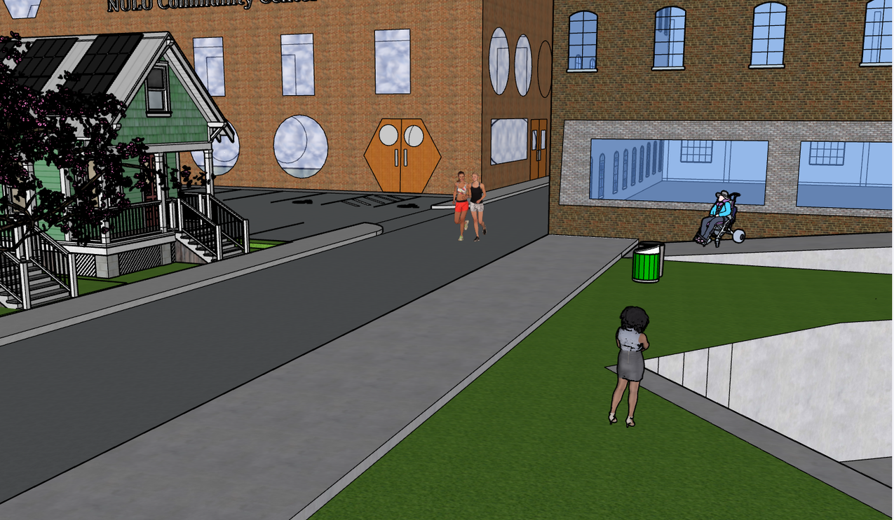
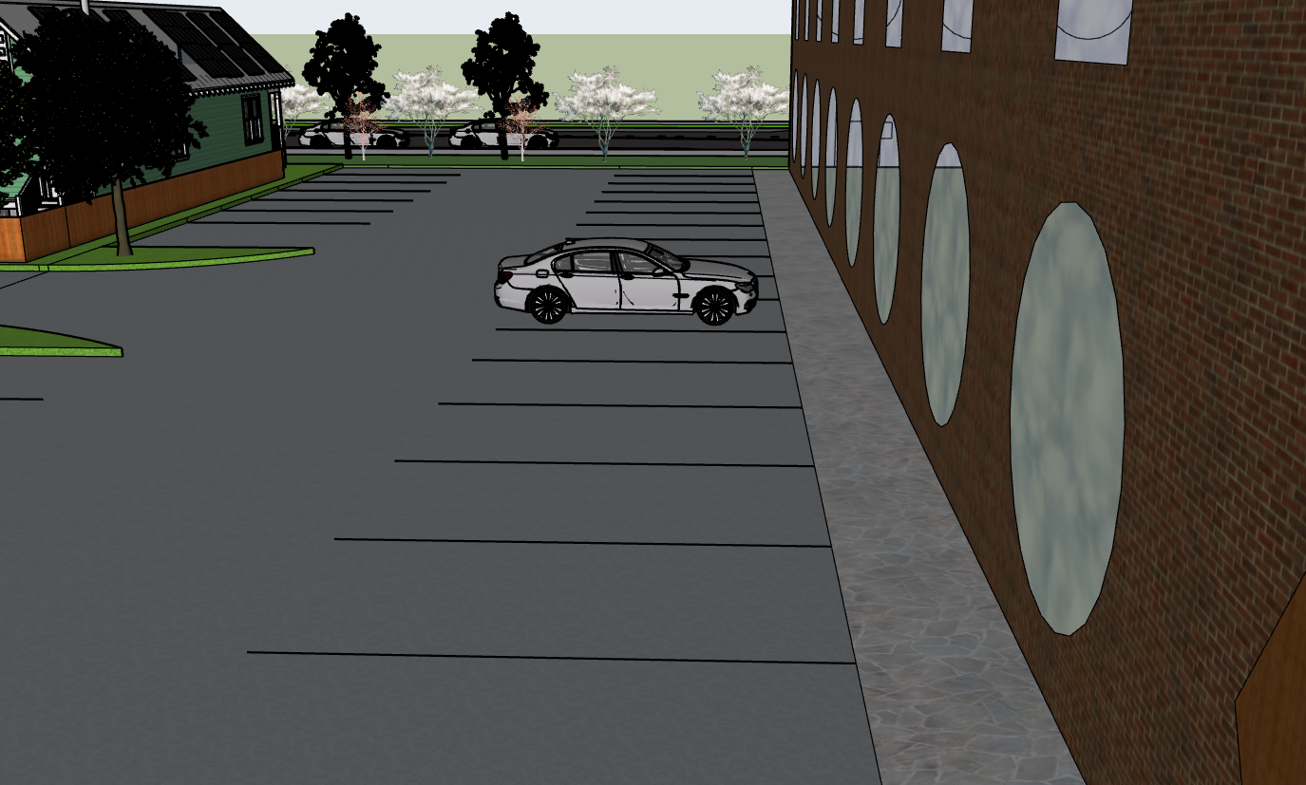
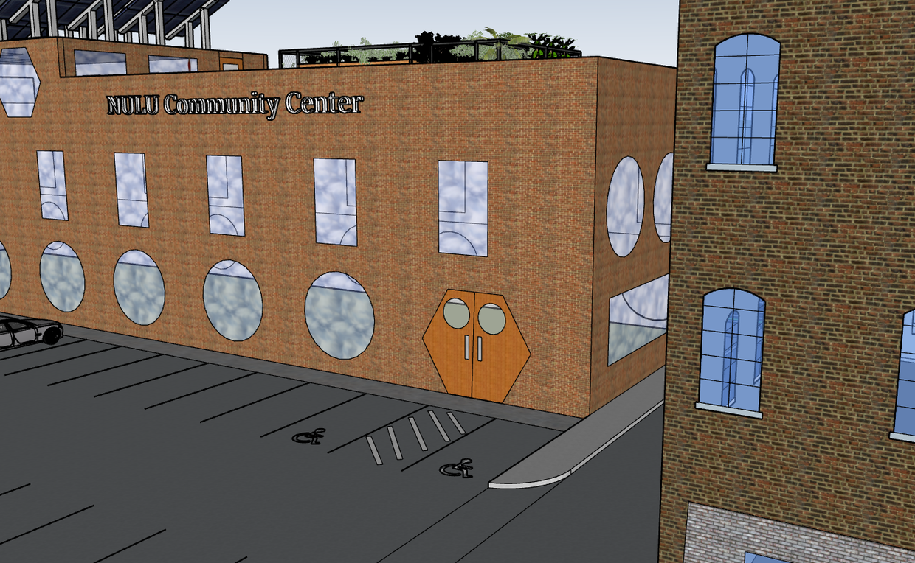
Walk down through the Community Center Parking Lot

Slide 28
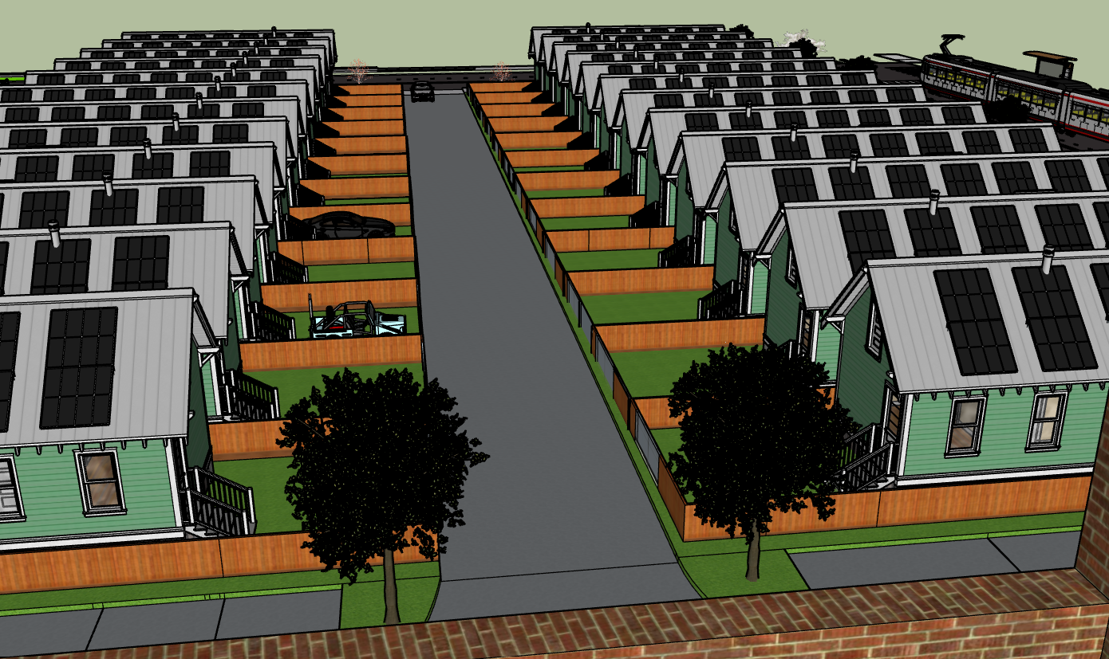
Woodland Place Ave

Slide 29
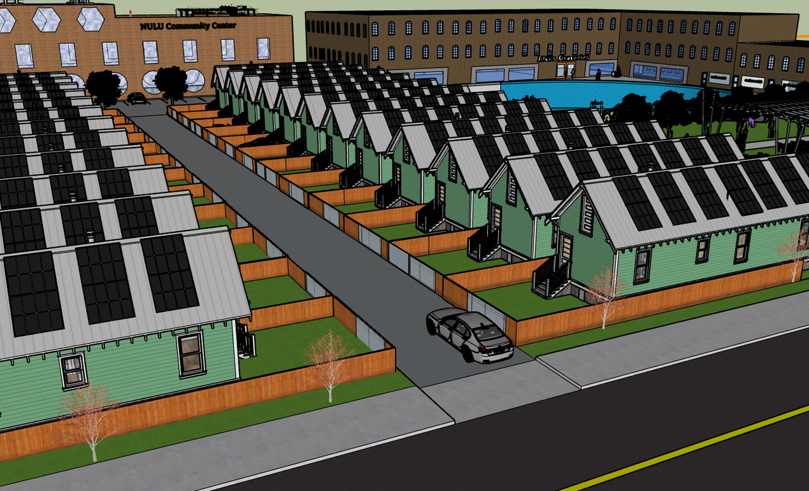
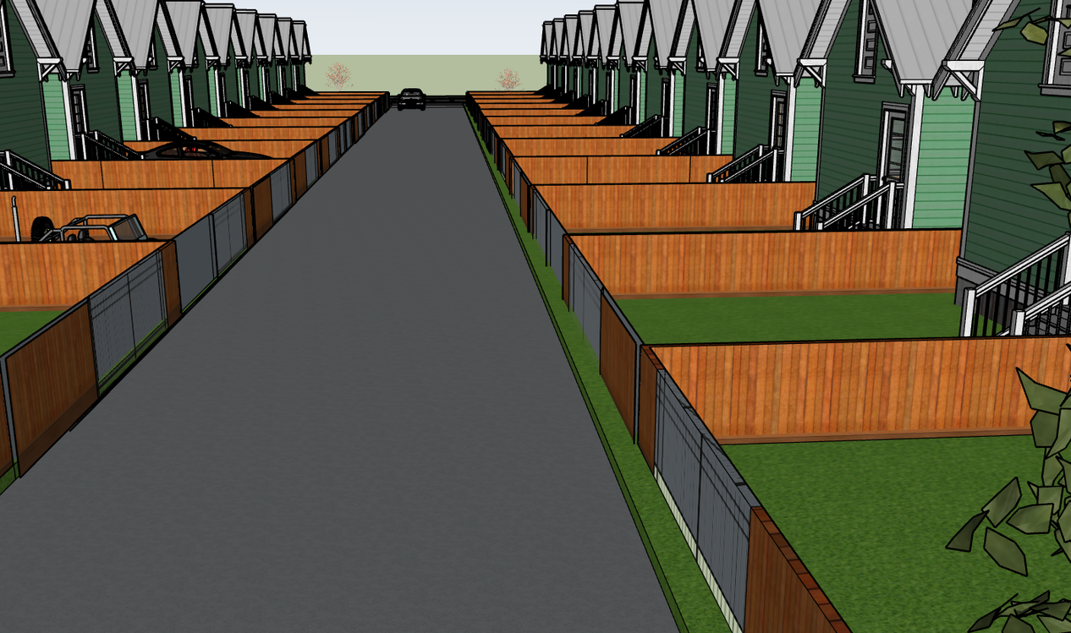
Walk Down Woodland Place Ave towards Baxter

Slide 30
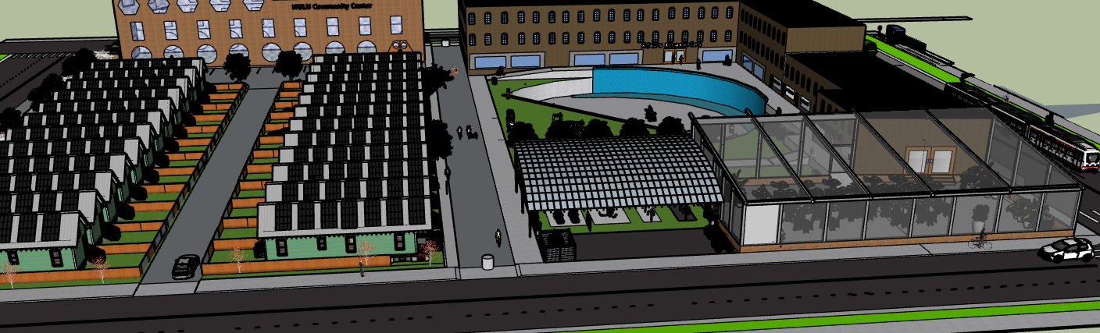
Amenities off Baxter

Slide 31


Slide 32

Conclusion
Community Connection and Green Living
  Solar panels on all new building
  Partner with River City Housing for zero Energy House under 200k
  Mixed income apartments
  Court is open to whole community not just residents
  Community Center with classes
  Better transportation and safer roads
  Partner with Kentucky Refugee resettlement agency for restaurants

